Slide 1
Instructions Suck;
Connections -> Better

Slide 2
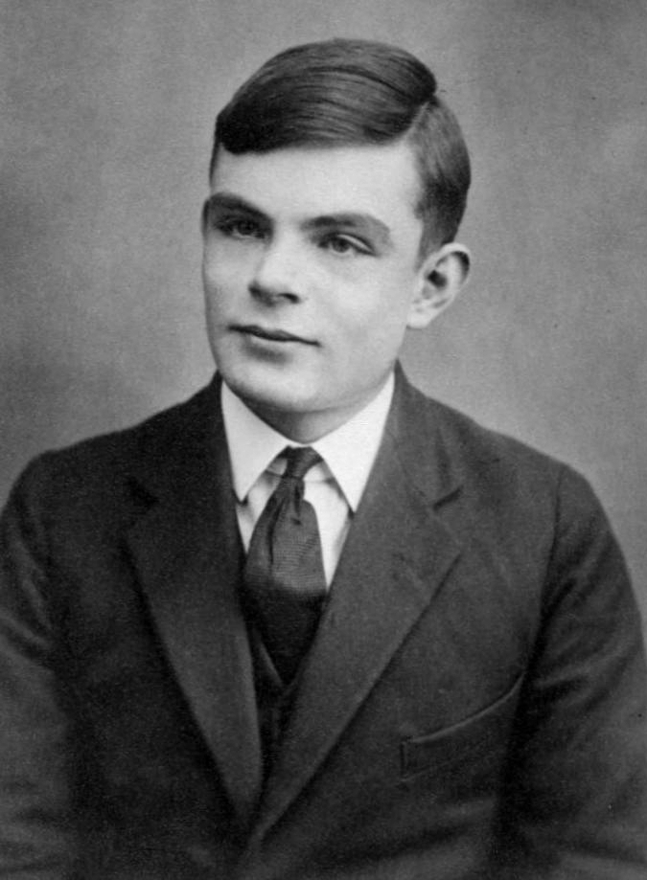

Turing Machines Suck Ass
two hard to understand
powerful only when vvveeeerrrryyy fast
boring symbol re-organizer
had to jank the math to make it work gud
wordcel only

Slide 3




People understand connections
Do all people feel like this? (I don’t know, I just work here)
  Electrical Schematics
  Social Relationships
  Railroads
  Networks
  Graphs
  Category Theory
  FPGAs

Slide 4
What if we made the symbol re-organizer execute a network?
A program is a list of connections between nodes
SHAPES (rotate them in your mind)
2
if >
Ouch!
User input

Slide 5
Lots of bad examples
Javascript Promises
  hard to read?
  Nobody understands?
  Looks like garbage?
LabVIEW (sorrynotsorry)
  no version control
  spaghetti code
  proprietary
Pure Data / Max/MSP (BANG!)
  no version control
  terrible ui
Node RED (MQTT in general)
  terrible ui
  no version control
Microservices? (aws style)
  terrible ui probably who even knows
GPU? (on real hardware heh)
  who knows
  Terrible UI (OpenGL)

Slide 6
For all you wordcels out there:
GRAPHS ARE BETTER THAN LISTS
  you can embed lists in graphs of course.
    good luck with lists it sux
      (/me says with a graph embedded in a list [that sucks in vc!])
  Turing machines == List processor (boring)
  network/schematic == Graph processor (fun!)
Once you have graphs, you just find the dependencies and ………………………………………………………….

Slide 7

SCHEDULING
You have to have it
  It’s the thing that makes it work
    You just schedule the graph nodes!
GUESS WHAT
  We already have it
    (wave’s at kernel process tree, libev, async, while(true), etc.)
So you just pipe all the *important* data between co-operating scheduled threads and everythings nice and accounted for
  (you implicitly avoid dependencies and make all interfaces explicit wherever you are :3)

Slide 8
AND THEN WE COULD GRAPH IT AGAIN
Readability good
The circle of life

Slide 9
Could code be readable?
Here we need a simple example to break down
  Show
let run () =
((let%lwt server =
Lwt_io.establish_server (Lwt_unix.ADDR_INET (Unix.inet_addr_any, 8765))
(fun (r, w) ->
let buffer = Bytes.create (16 * 1024) in
copy_blocks buffer r w)
in
Lwt.return server) : Lwt_io.server Lwt.t) |> ignore

Slide 10
MONADS
MONAD
MONAD
MONAD
MONAD

